Slide 1


NYC Traffic Accidents Analysis
Analysing the trends, identifying contributing factors and recommending measures.
Excel Project
Data Source: Maven Analytics
Vineet Khurana

Slide 2
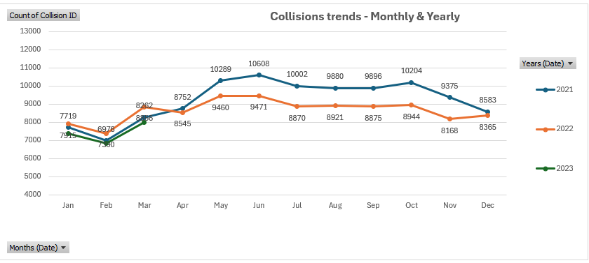
Collision trends indicate a continued decline, with a 6% reduction in 2022 compared to 2021. Preliminary data for 2023 suggests this downward trajectory is being maintained.
Seasonal analysis reveals an increase in collisions from May to October, with June experiencing the highest frequency of incidents.
February consistently records the lowest number of collisions, highlighting a period of reduced risk.

Slide 3
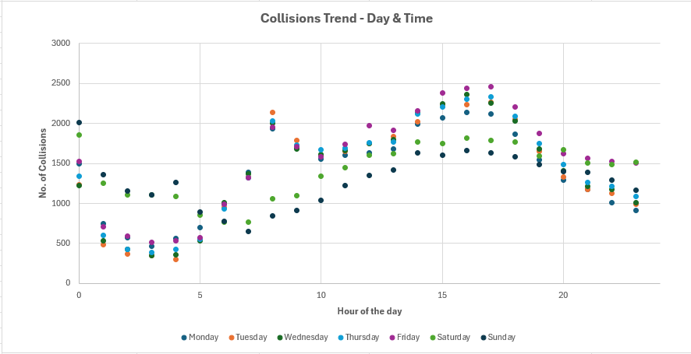
Peak collision hours are observed between 2:00 PM and 6:00 PM, indicating a high-risk period requiring targeted interventions.
Fridays experience the highest number of collisions, exceeding the weekly average by 8%, emphasizing the need for enhanced safety measures at the week's end.
Collision patterns on Saturdays and Sundays deviate from the typical weekly trend, suggesting different driving behaviors and risk factors on weekends.

Slide 4
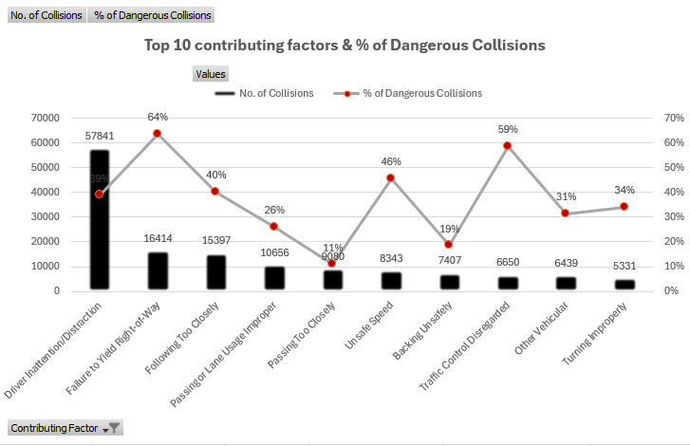
Driver inattention and distraction remain the primary contributing factors to collisions, highlighting the need for targeted awareness and enforcement initiatives.
Failure to yield the right-of-way and disregard for traffic control measures are the two leading causes of severe collisions, often resulting in injuries and fatalities. Strengthening compliance and enforcement in these areas is critical to enhancing road safety.

Slide 5
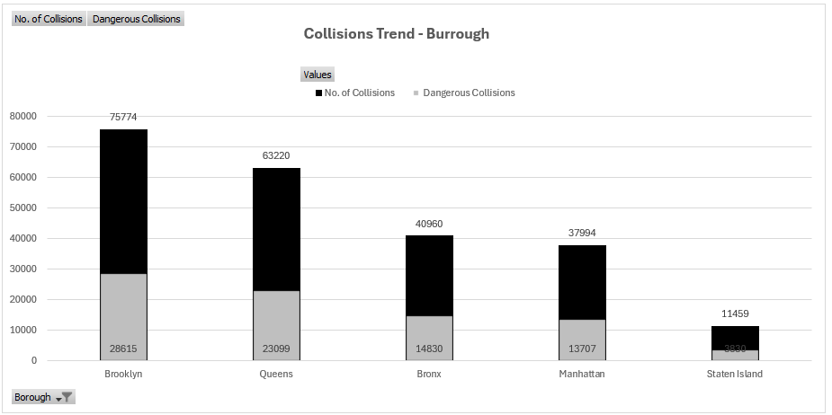
Brooklyn reports the highest number of collisions, including the most severe and high-risk incidents, emphasizing the need for enhanced safety measures in this borough.
Queens ranks second in both total collisions and severe collisions, indicating a critical area for targeted traffic interventions.
The proportion of high-risk collisions remains consistent across all boroughs, averaging around 35%, underscoring the widespread nature of this safety concern and the need for borough-wide mitigation strategies.

Slide 6
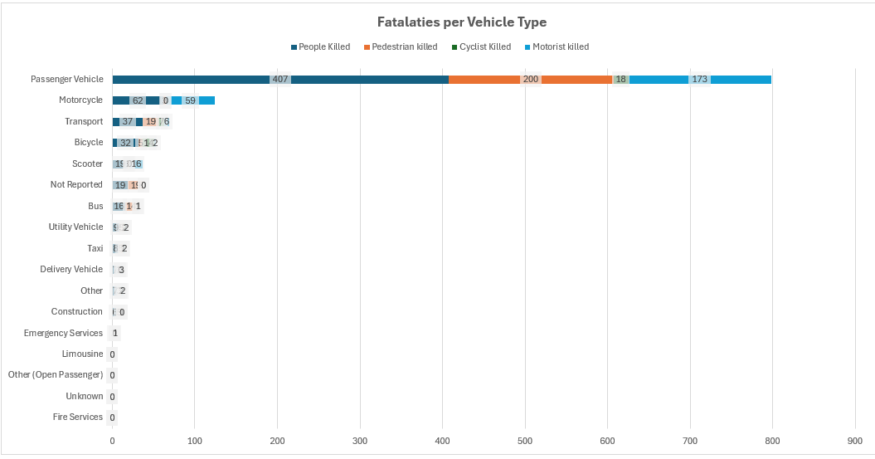
Passenger vehicles are involved in 85% of all collisions and account for 65% of total fatalities, highlighting the need for stricter enforcement of traffic regulations and driver safety initiatives.
Motorcyclists face a significantly higher fatality risk in severe collisions, emphasizing the importance of enhanced protective measures, awareness campaigns, and infrastructure improvements for rider safety

Slide 7
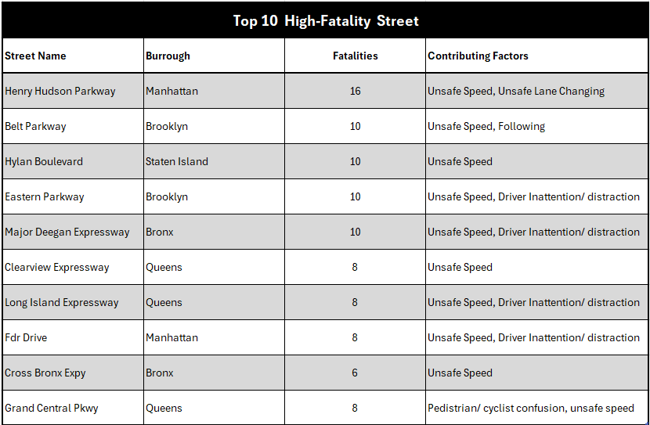
Henry Hudson Parkway ranks as the highest-risk roadway, requiring targeted safety interventions to mitigate collision hazards.
Excessive speed is the leading factor in fatal collisions, underscoring the need for stricter speed enforcement and enhanced roadway safety measures.

Slide 8
Recommendations
Implement stricter traffic enforcement measures between May and July, the period with the highest collision risk, to enhance road safety.
Launch targeted public awareness radio ads between 2 PM and 6 PM, the peak hours for collisions, to promote safer driving behaviors.
Ban the use of mobile and electronic devices by front-seat passengers, enforcing strict penalties to minimize distractions.
Deploy speed cameras and impose substantial fines on the top 10 high-fatality streets to deter reckless driving and reduce fatalities.
Expand traffic-calming measures, such as speed bumps, enhanced signage, and road redesigns, in areas with frequent collisions.
Enhance driver licensing requirements, placing greater emphasis on yielding the right-of-way, maintaining a safe following distance, and understanding the dangers of excessive speed.
Enhance law enforcement presence on high-risk roads, such as Henry Hudson Parkway, to prevent speeding and unsafe driving behaviors.
Prioritize Brooklyn and Queens for the initial implementation of these measures, given their high collision and fatality rates.
Strengthen motorcycle safety initiatives, including increased visibility measures (reflective gear and daytime running lights), and dedicated motorcycle lanes on high-risk roads.

Slide 9
